Slide 1
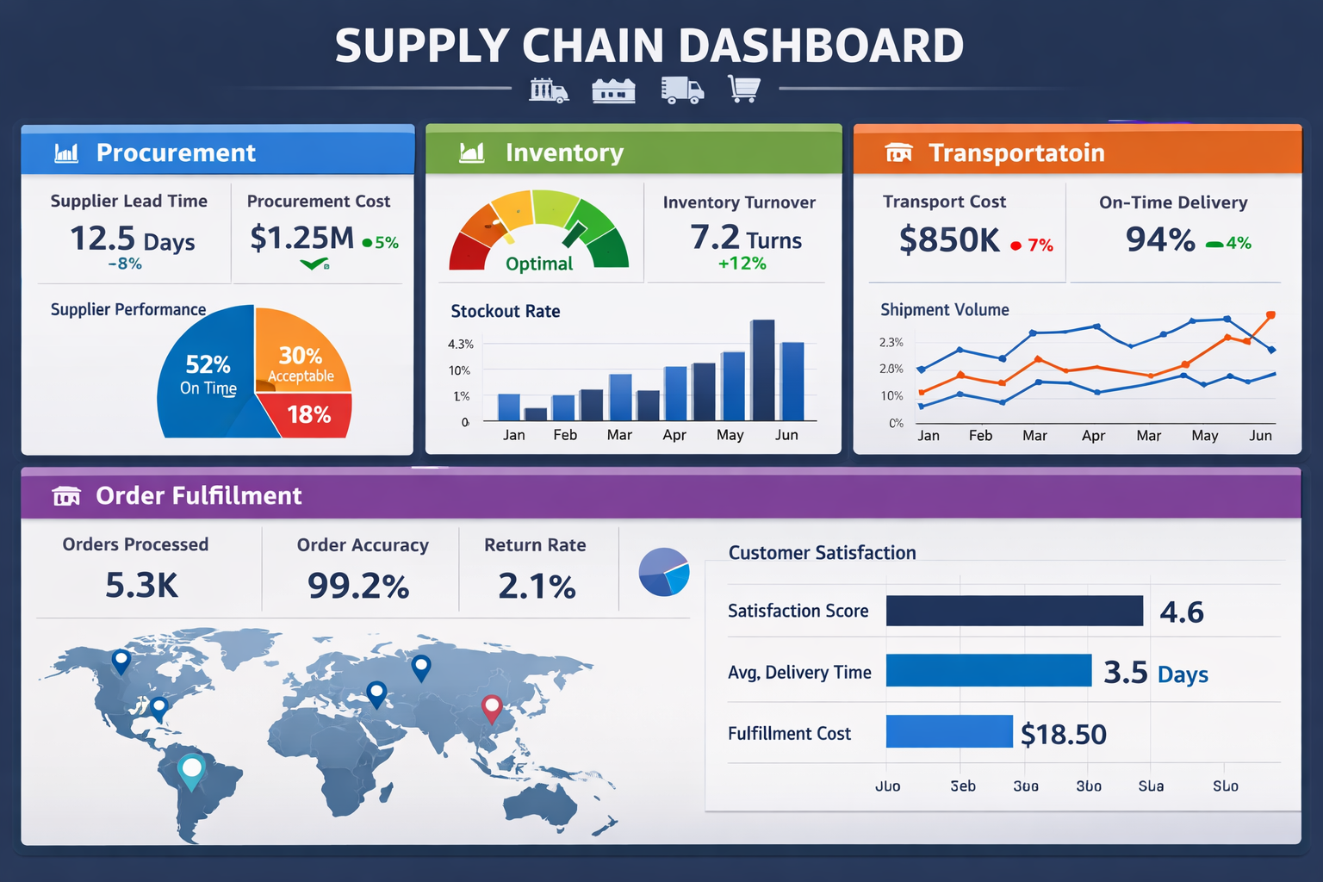
Supply Chain Performance Analysis
“A Comprehensive Dashboard‑Based Evaluation of Supply Chain Performance”
Presented By
Nikhil Kumar Reddy
nikhilkumarreddy1354@gmail.com
CDA 10th Nov Batch

Slide 2
Project Overview
The Supply Chain Analysis Project focuses on evaluating the efficiency and performance of key supply chain components — including procurement, inventory, manufacturing, logistics, and customer fulfillment
Improve supplier reliability and cost efficiency
Optimize inventory levels and reduce stockouts
Streamline logistics and delivery performance
Enhance customer satisfaction and operational transparency

Slide 3
Objectives Of Project
Evaluate Supplier Performance:
Analyze supplier efficiency through metrics like lead time, defect rate, cost per unit,
and manufacturing cost to identify reliable and cost‑effective suppliers.
Optimize Inventory Management:
Monitor stock levels, order quantities, and availability to maintain balanced inventory
and reduce stockouts or overstocking.
Enhance Manufacturing Efficiency:
Assess production volumes, defect rates, and lead times to improve production planning
and minimize operational delays

Slide 4
Improve Logistics and Transportation:
Examine shipping cost, time, and transportation modes to streamline delivery routes and reduce logistics expenses.
Maximize Revenue and Profitability:
Track total revenue and cost distribution across routes, suppliers, and product types to identify high‑performing areas and optimize resource allocation.
Enable Data‑Driven Decision Making:
Use interactive dashboards (Power BI) to visualize KPIs and support strategic decisions across procurement, inventory, manufacturing, and logistics.

Slide 5
About Dataset
The dataset provides a comprehensive view of a company’s supply chain operations, covering every stage from procurement to customer delivery. It integrates multiple dimensions of business performance, enabling end‑to‑end analysis and optimization.
This dataset helps analyze supplier performance, inventory efficiency, manufacturing productivity, and logistics optimization, providing actionable insights to improve overall supply chain effectiveness and profitability.

Slide 6
Tools and Technologies used
📊 Power BI – Interactive dashboards & KPI visualization
🗄️ SQL – Querying, cleaning, and managing structured data
📑 Excel – Preprocessing, calculations, and quick analysis
🐍 Python – Advanced analytics, automation, and modeling
🔄 ETL Processes – Data extraction, transformation, and loading
📈 Data Visualization – Charts, graphs, and maps for insights

Slide 7
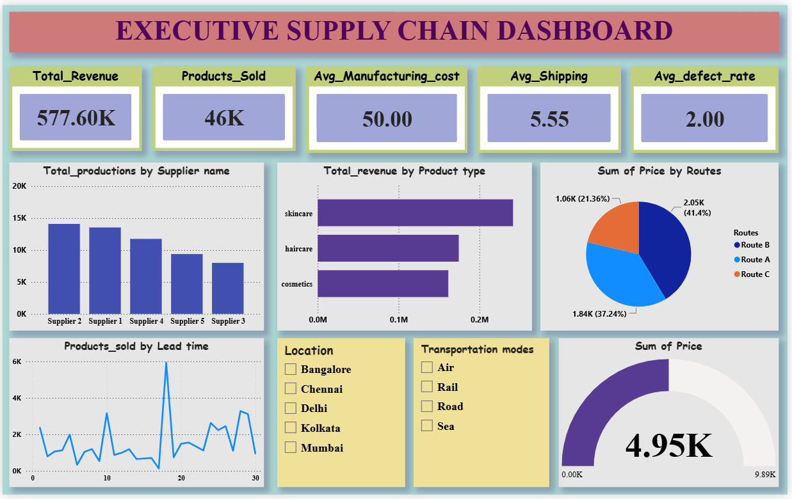

Slide 8
KPIs
💰 Revenue: ₹577.60K
📦 Products Sold: 46K
🏭 Manufacturing Cost: ₹50/unit
🚚 Shipping Cost: ₹5.55/unit
✅ Defect Rate: 2%
Insights
Supplier 2 leads production (~15K units).
Skincare category drives highest revenue (~0.2M).
Route A contributes 41% of total price → most efficient.
Balanced supply chain with low defect rate and stable lead times.

Slide 9
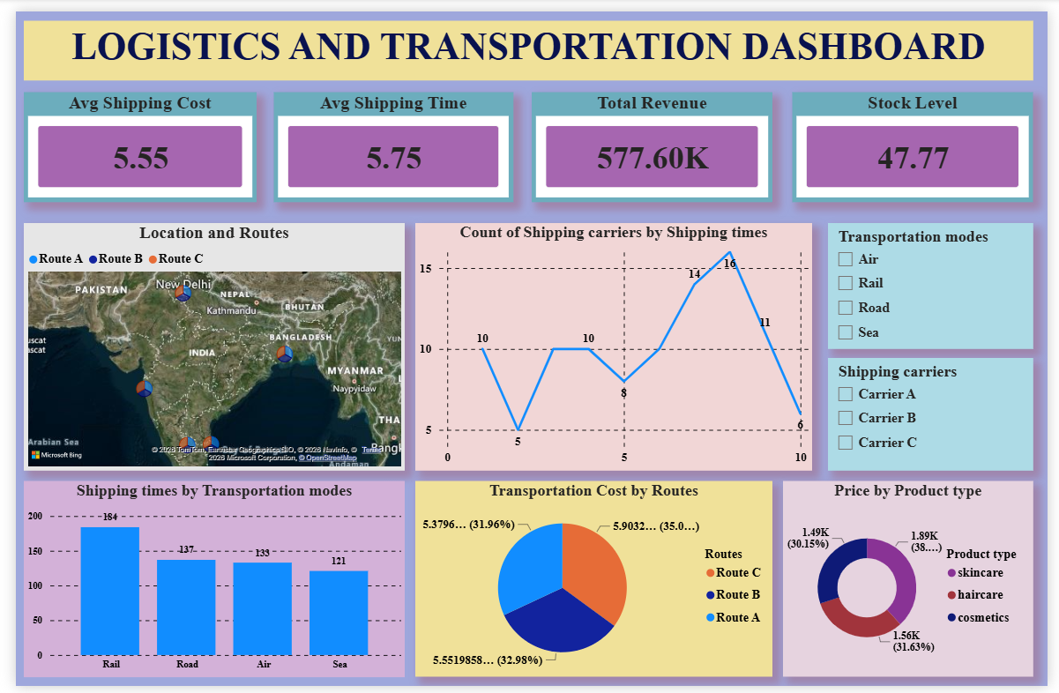

Slide 10
KPIs (Quick Metrics)
💰 Total Revenue: ₹577.60K
🚚 Avg. Shipping Cost: ₹5.55 per unit
⏱️ Avg. Shipping Time: 5.75 days
📦 Stock Level: 47.77 units
Strategic Insights
Transportation Mode Efficiency: Rail handles the highest volume (184 shipments) → most cost‑effective.
Route Cost Distribution: Route C has the highest cost (35%) → potential for optimization.
Product Profitability: Skincare leads with 38% of total revenue → strongest category.
Carrier Utilization: Peak performance at mid‑range shipping times → balanced operations.
Geographical Reach: Routes cover major Indian cities → strong national distribution network.

Slide 11
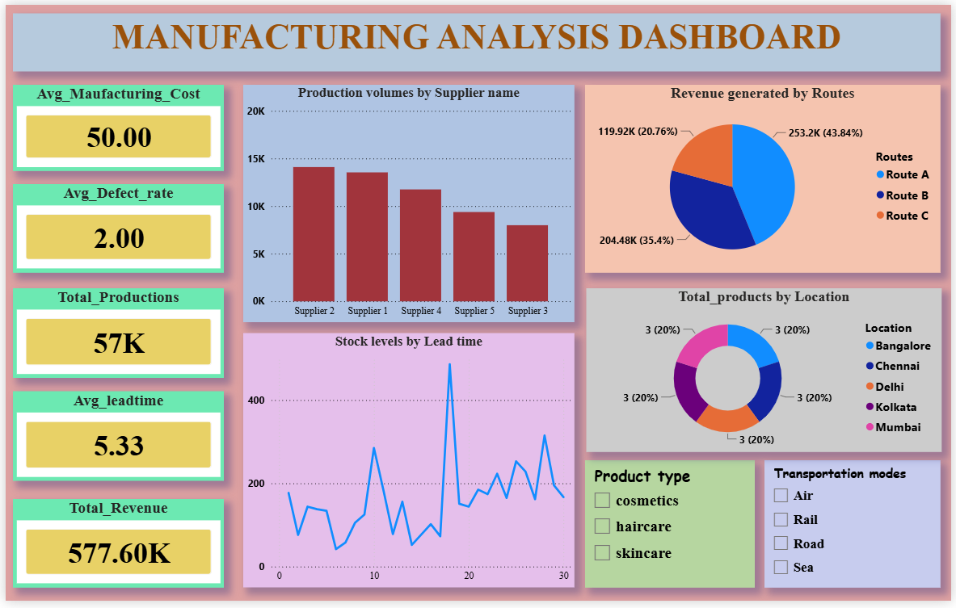

Slide 12
Key Performance Indicators (KPIs)
💰 Revenue: ₹577.60K
📦 Products Sold / Production: 46K–57K units
🏭 Avg. Manufacturing Cost: ₹50 per unit
🚚 Avg. Shipping Cost: ₹5.55 per unit
⏱️ Avg. Lead Time / Shipping Time: ~5–6 day
Strategic Insights
Supplier Performance: Supplier 2 & Supplier 1 lead production (~15K units each).
Route Efficiency: Route A generates highest revenue (43–44%) → most profitable.
Transportation Modes: Rail handles maximum shipments (184) → cost‑effective.
Product Profitability: Skincare contributes the largest revenue share (~38%).
Stock Levels: Fluctuations across lead times → need for scheduling optimization.

Slide 13
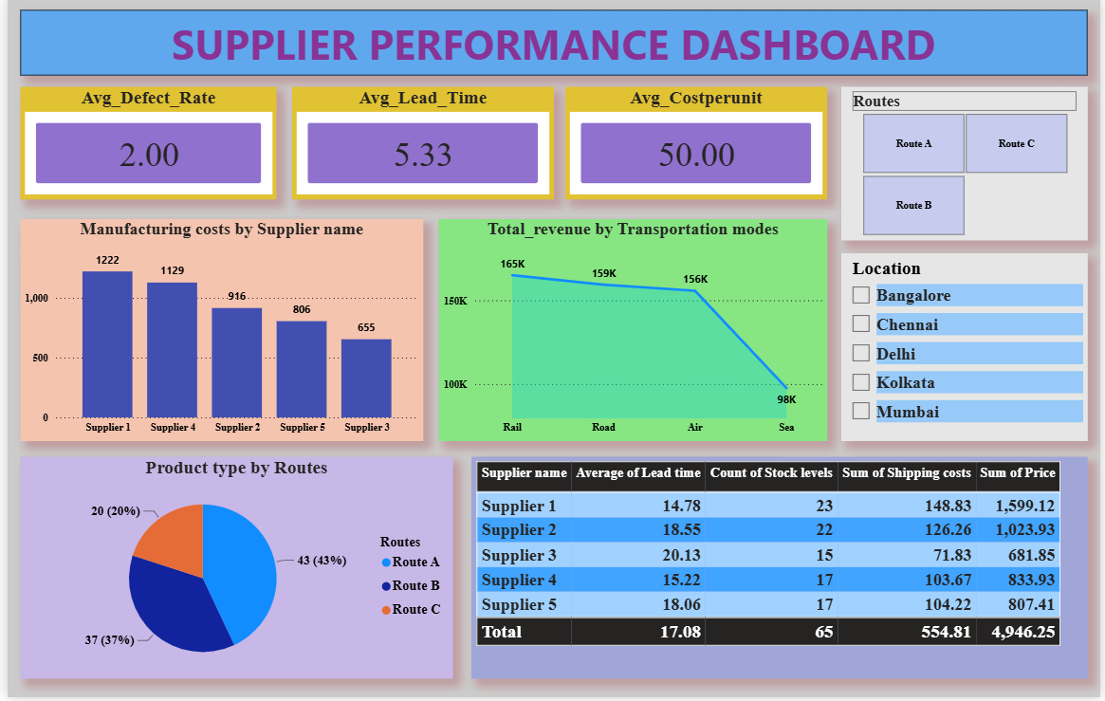

Slide 14
Key KPIs
✅ Average Defect Rate: 2%
⏱️ Average Lead Time: 5.33 days
💰 Average Cost per Unit: ₹50
💡 Insights
Supplier 1 has the highest manufacturing cost (₹1,222) → premium production quality.
Rail mode generates the highest revenue (₹165K) → most efficient transportation.
Route A handles the largest share of products (43%) → key distribution channel.
Supplier 1 contributes the highest total price (₹1,599.12) → top‑performing supplier.
Sea transport shows lowest revenue (₹98K) → potential area for improvement.

Slide 15
Recommendations
Optimize Route C → Reduce high logistics costs.
Scale Rail Transport → Most efficient & profitable mode.
Prioritize Skincare Products → Strongest revenue driver.
Strengthen Supplier Partnerships → Focus on Supplier 1 & 2.
Standardize Lead Times → Minimize variability in stock & shipping.
Maintain Quality Control → Keep defect rate at 2%.
Ensure Regional Balance → Continue equal distribution across cities

Slide 16
Conclusion
This project demonstrates how integrated dashboards for supply chain, logistics, manufacturing, and supplier performance provide a clear, data‑driven view of operations. By tracking key KPIs and analyzing insights across all areas, the organization can optimize costs, improve efficiency, strengthen supplier collaboration, and focus on profitable product lines. Overall, the dashboards enable smarter decision‑making and position the supply chain for sustainable growth and scalability

Slide 17


